Slide 1
I’d like to teach the world to think Computationally
Charles Severance
University of Michigan
School of Information

Slide 2
T E C H
P
R
O
S
EVERYONE
ELSE
N
O
N
T E C H
Notes:
Questions: Who in this room makes their living as a professional programmer or system adinistrator – 8 hours per day? How many people have good-paying jobs where you never touch or use technology?

Slide 3
Is there a course that could be developed that would improve understanding of technology across the board to prepare people for the good jobs in the 21st century?
Is there one class that should be required for every student in high school and college?

Slide 4
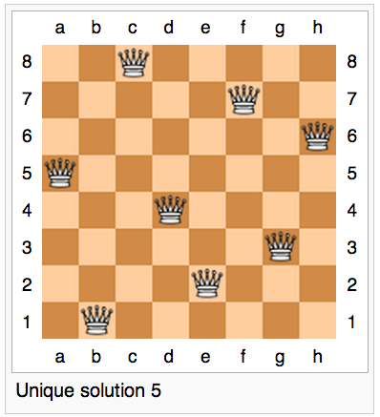
http://en.wikipedia.org/wiki/Eight_queens_puzzle
Notes:
We make the mistake far too often to equate computational thinking with “Introduction to Computer Science”. In high school we would call this “AP Computer Science”. Should we just force everyone to take AP Computer Science to solve this 21st century problem?

Slide 5
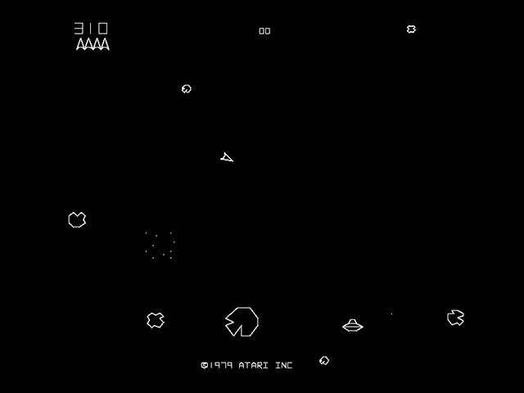
http://en.wikipedia.org/wiki/Asteroids_(video_game)

Slide 6
Velocity
http://en.wikipedia.org/wiki/Asteroids_(video_game)

Slide 7
Θ
Velocity
cos Θ
sin Θ
http://en.wikipedia.org/wiki/Asteroids_(video_game)

Slide 8
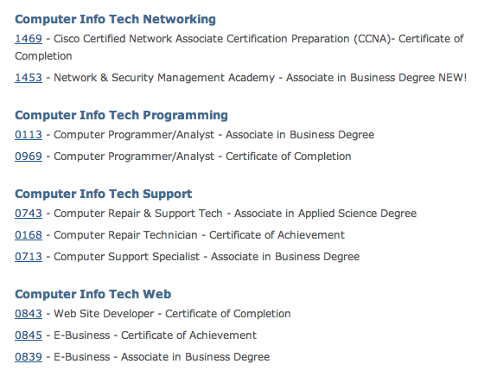
http://www.lcc.edu/cit/curriculum/
Notes:
There are four more “technology” majors.

Slide 9
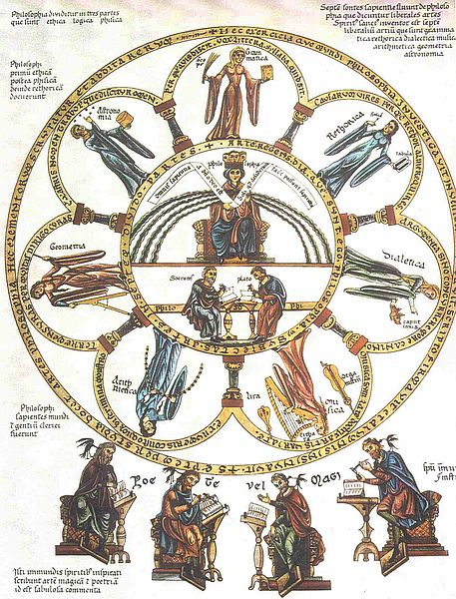
The liberal arts (Latin: artes liberales) are those subjects or skills that in classical antiquity were considered essential for a free person (a citizen) to know in order to take an active part in civic life
http://en.wikipedia.org/wiki/Liberal_arts_education
Notes:
I propose something different... Something that is essential to be a “free” (as in freedom) citizen. Being skilled and informed is essential to being a free citizen.

Slide 10
Photo of SI502 Classroom

Slide 11
WHAT NEXT?

Slide 12
WHAT DO YOU WANT ME TO DO NEXT?
http://www.youtube.com/watch?v=y39D4529FM4

Slide 13
Programs for Humans
while music is playing:
Left hand out and up
Right hand out and up
Flip Left hand
Flip Right hand
Left hand to right shoulder
Right hand to left shoulder
Left hand to back of head
Right ham to back of head
Left hand to right hit
Right hand to left hit
Left hand on left bottom
Right hand on right bottom
Wiggle
Wiggle
Jump
http://www.youtube.com/watch?v=vlzwuFkn88U
http://www.youtube.com/watch?v=sN62PAKoBfE

Slide 14
Errors in Programs for Humans
while music is playing:
Left hand out and up
Right hand out and up
Flip Left hand
Flip Right hand
Left hand to right shoulder
Right hand to left shoulder
Left hand to back of head
Right ham to back of head
Left hand to right hit
Right hand to left hit
Left hand on left bottom
Right hand on right bottom
Wiggle
Wiggle
Jump
http://www.youtube.com/watch?v=vlzwuFkn88U
http://www.youtube.com/watch?v=sN62PAKoBfE

Slide 15
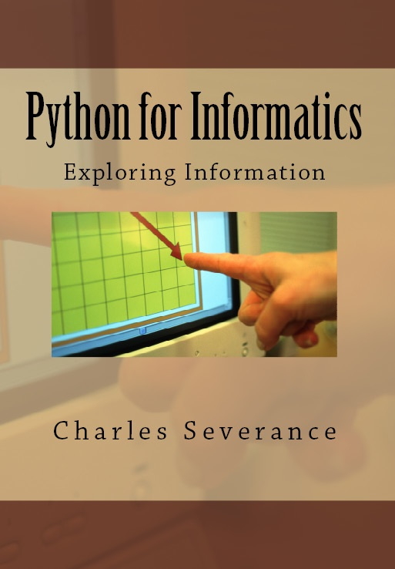
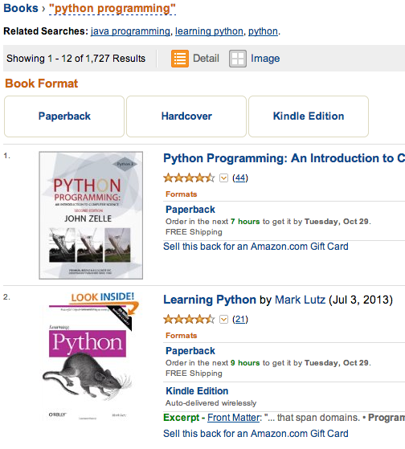

Slide 16
SI502 Data

Slide 17
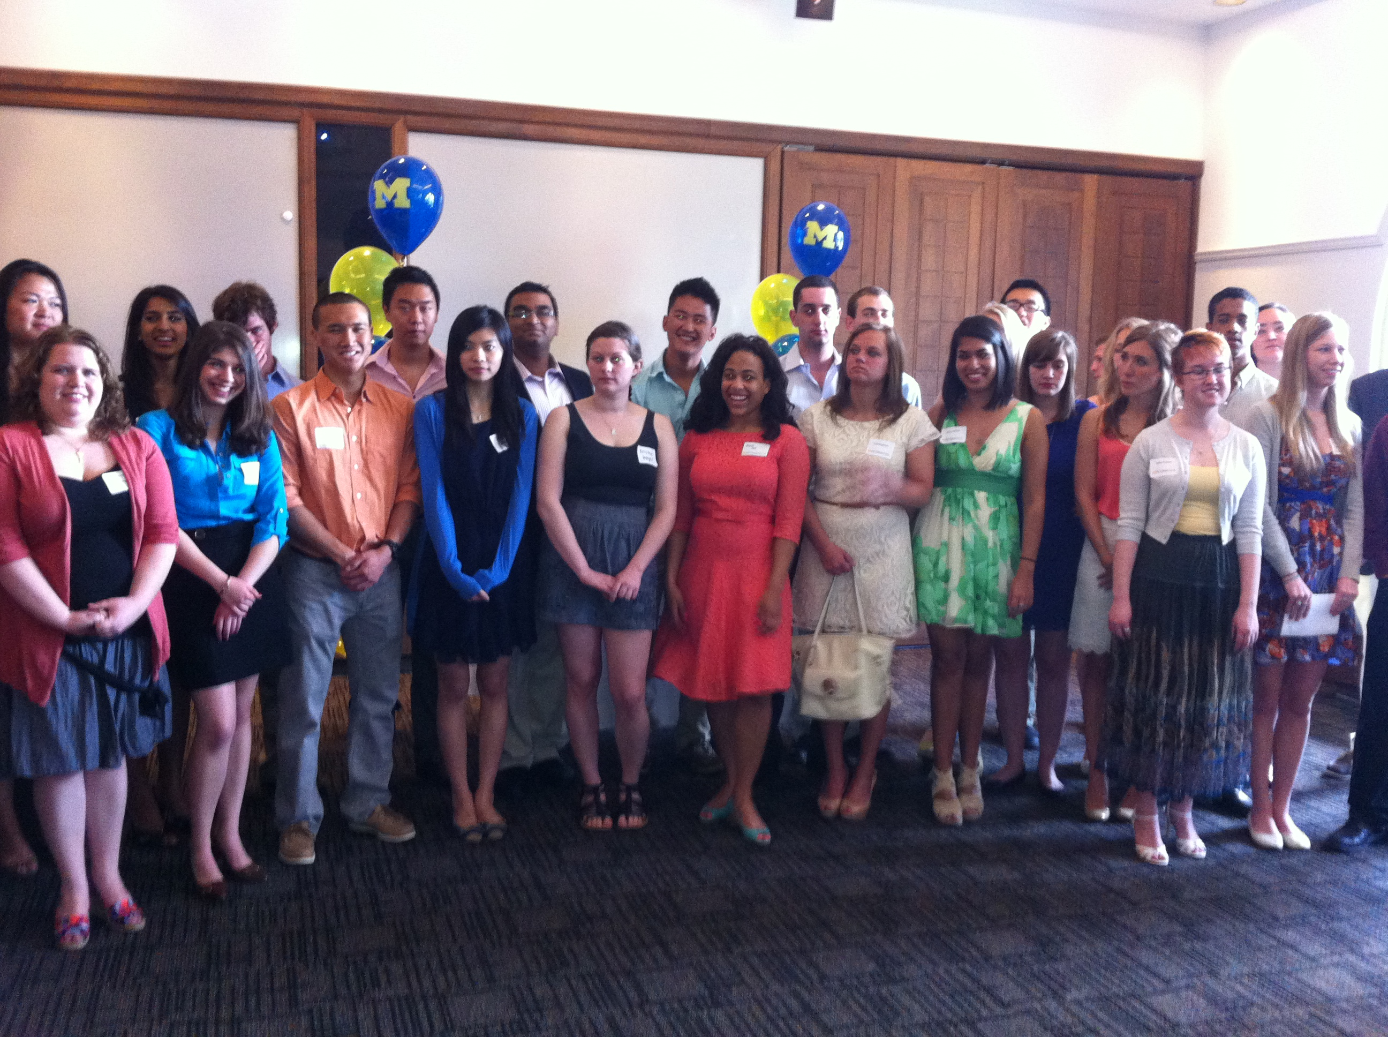
University of Michigan Informatics Graduation Reception – April 2013

Slide 18
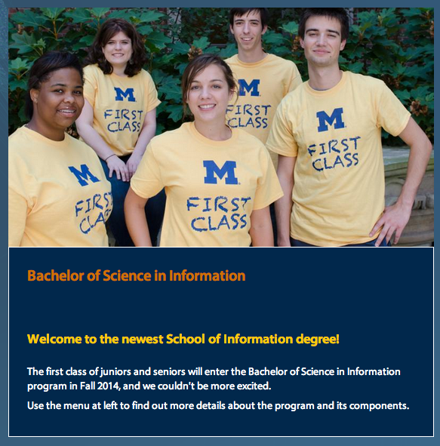

Slide 19
I would like to teach the World to think Computationally.

Slide 21
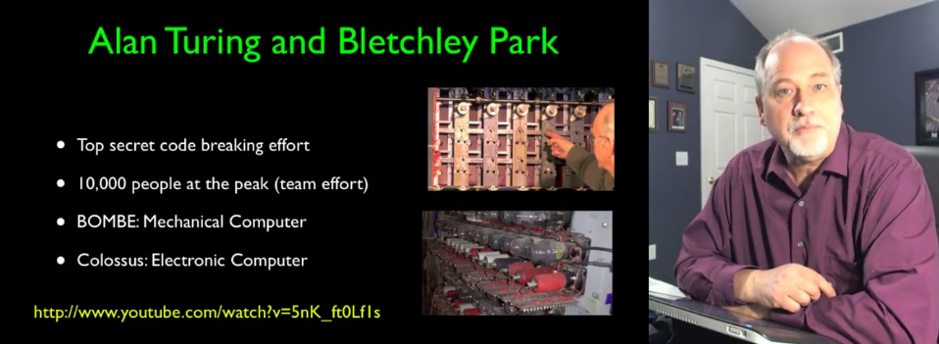

Slide 22
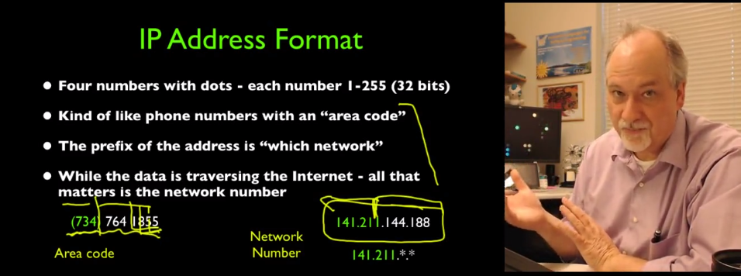
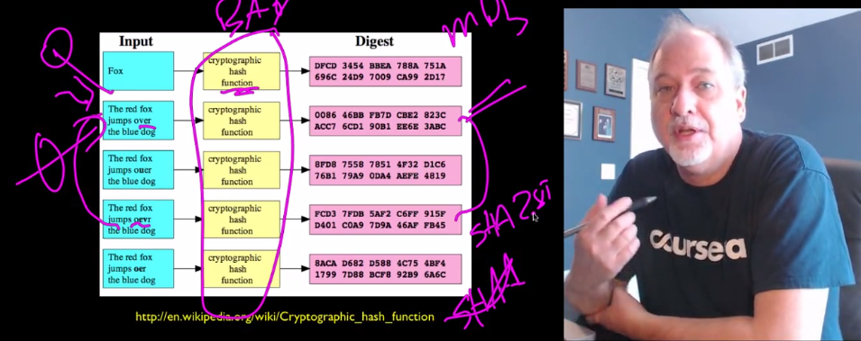

Slide 23
N=4701
http://www.dr-chuck.com/coursera/insidetheinternet/2012-001/maps/where.html

Slide 24
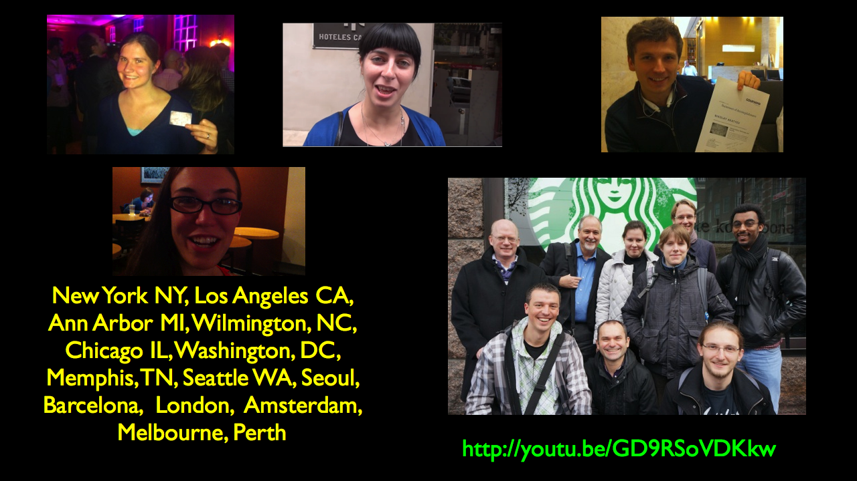

Slide 25
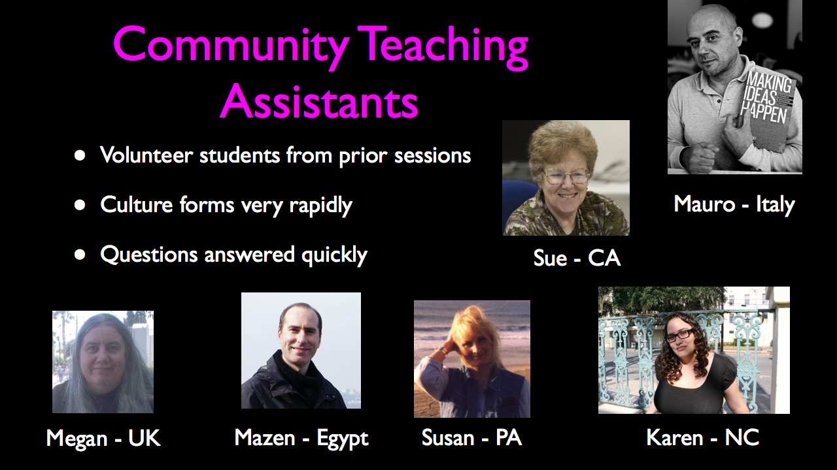

Slide 26
Start Class: 31343
Finish Class: 12804 (41%)
Enrollment: 139375
Attend One Lecture: 53958

Slide 27
I would like to teach the World to think Computationally.
Notes:
Taught about why, and what. It is finally time to teach “how”.

Slide 28
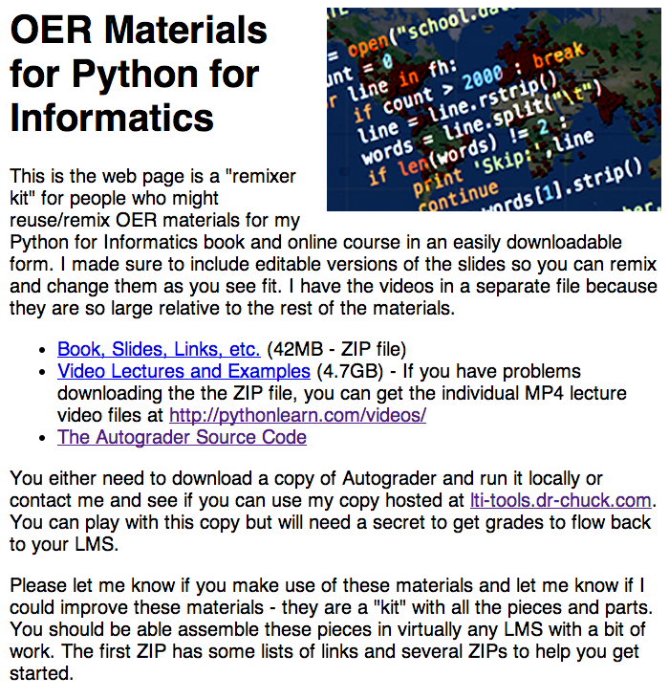
http://www.pythonlearn.com

Slide 29
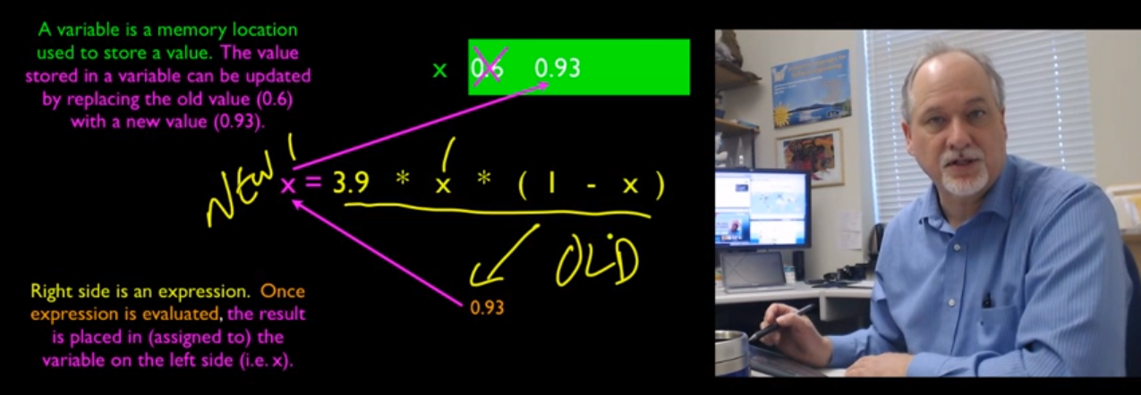
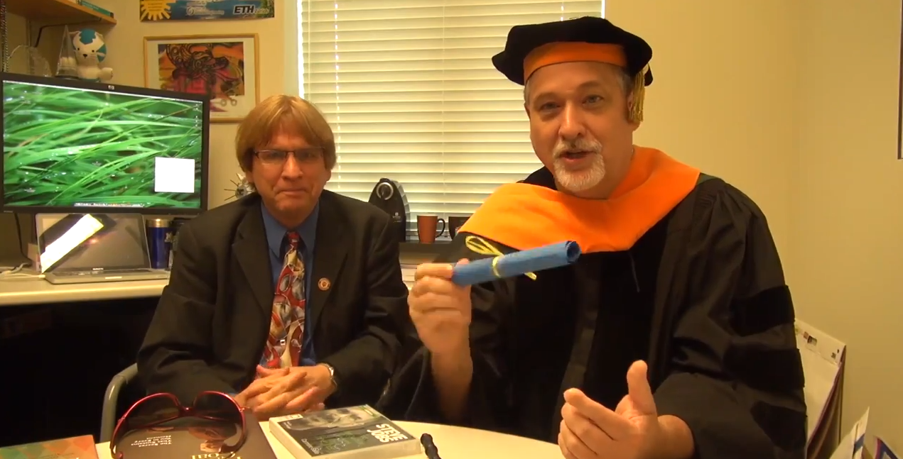

Slide 32
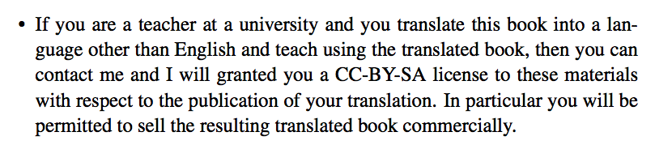

Slide 33
http://www.youtube.com/watch?v=VY-Ogkc7Mnw

